Slide 1
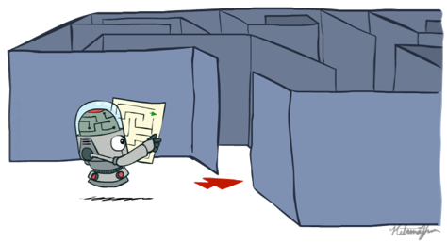
Artificial Intelligence
Ch3: Problem Solving by Search
Instructor: Iyad Alshami
[These slides adopted from Dan Klein and Pieter Abbeel at UC Berkeley ai.berkeley.edu]
Notes:
[These slides adopted from Dan Klein and Pieter Abbeel at UC Berkeley ai.berkeley.edu]
Build agents that plans ahead. Act rationally.

Slide 2
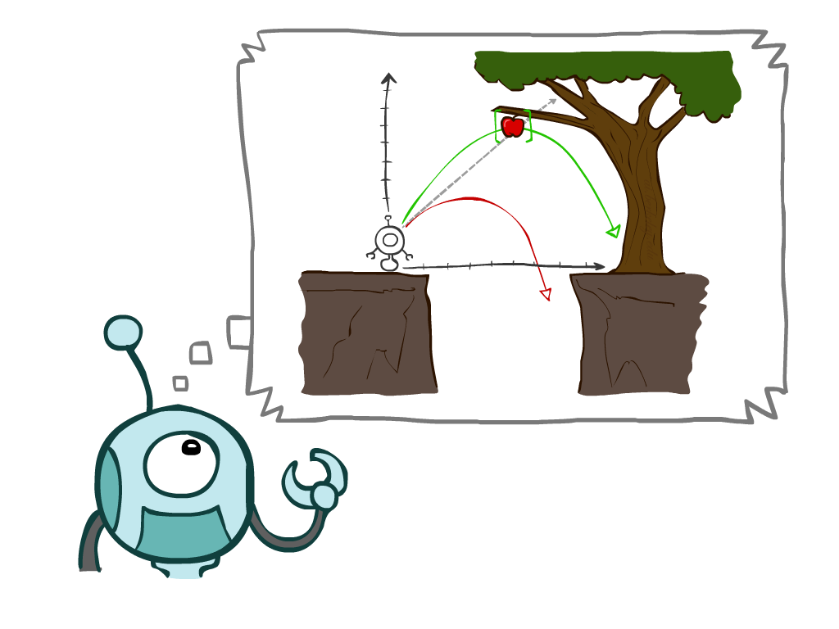
Chapter Outline
3.1 Problem-Solving Agents
3.2 Example Problems
3.3 Search Algorithms
3.4 Uninformed Search Strategies
Depth-First Search
Breadth-First Search
Uniform-Cost Search
3.5 Informed (Heuristic) Search Strategies
3.6 Heuristic Functions
Notes:
Many you have seen before.
General theme in the class:
A goal we have in mind.
A mathematical abstraction to formalize this
Algorithms that operate on these abstractions
Unified formalism leading to A* search (search guided by heuristic)

Slide 3
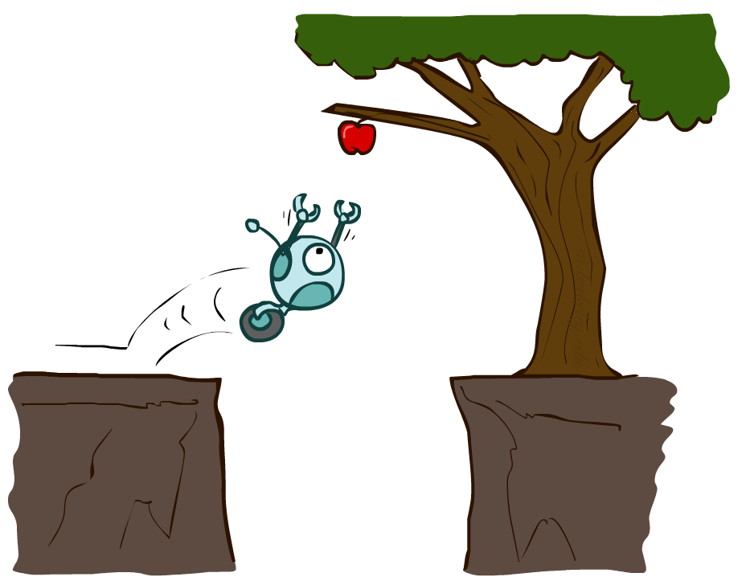
Reflex Agents
Reflex agents:
Choose action based on current percept (and maybe memory)
May have memory or a model of the world’s current state
Do not consider the future consequences of their actions
Consider how the world IS
Can a reflex agent be rational?
Notes:
Fall; bad idea;
Reflex – lookup from state to action. Don’t consider the future consequences of your actions
Examples: blinking your eye (not using your entire thinking capabilities), vacuum cleaner moving towards nearest dirt
Can a reflex agent be rational?

Slide 4
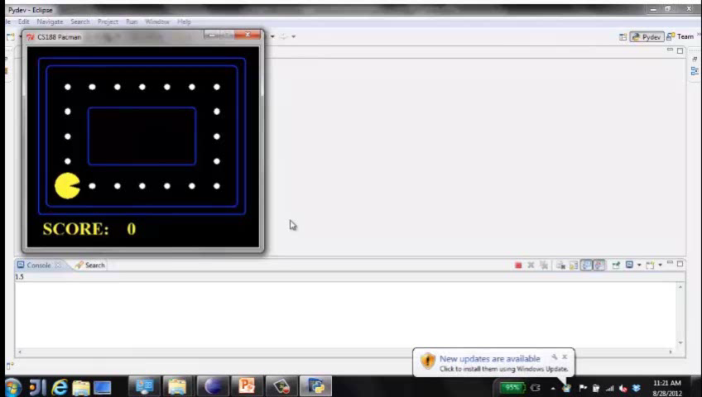
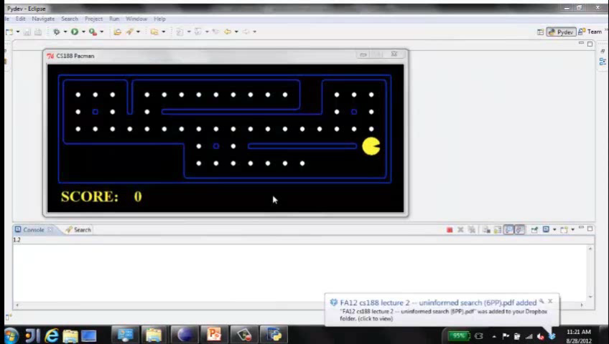
Demo of Reflex Agent
Demo Reflex Optimal
Demo of Reflex Odd
L2D1: Move in the direction of the nearest uneaten dot. You can think ahead all you want, still end up doing the same thing.
L2D2: NO planning. Wall between you and nearest dot?
Reflex agents not generally optimal, but they can be depending on circumstance.
Optimality is not defined by algorithm, but by rational behavior.
Notes:
L2D1
Move in the direction of the nearest uneaten dot. You can think ahead all you want, still end up doing the same thing.
Can be rational.
L2D2
NO planning. Wall between you and nearest dot?
Reflex agents not generally optimal, but they can be depending on circumstance.
Optimality is not defined by algorithm, but by rational behavior.

Slide 5
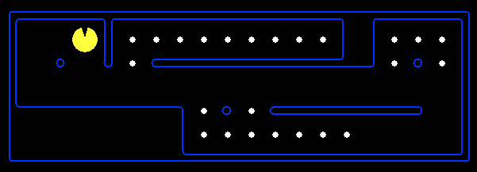
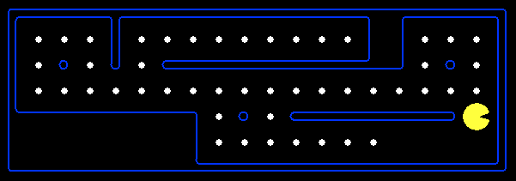
Reflex Agents
Reflex agent is simple
base their actions on
a direct mapping from states to actions
but cannot work well in environments
which this mapping would be too large to store
and would take too long to learn
Hence, goal-based agent is used
Notes:
Fall; bad idea;
Reflex – lookup from state to action. Don’t consider the future consequences of your actions
Examples: blinking your eye (not using your entire thinking capabilities), vacuum cleaner moving towards nearest dirt
Can a reflex agent be rational?

Slide 6
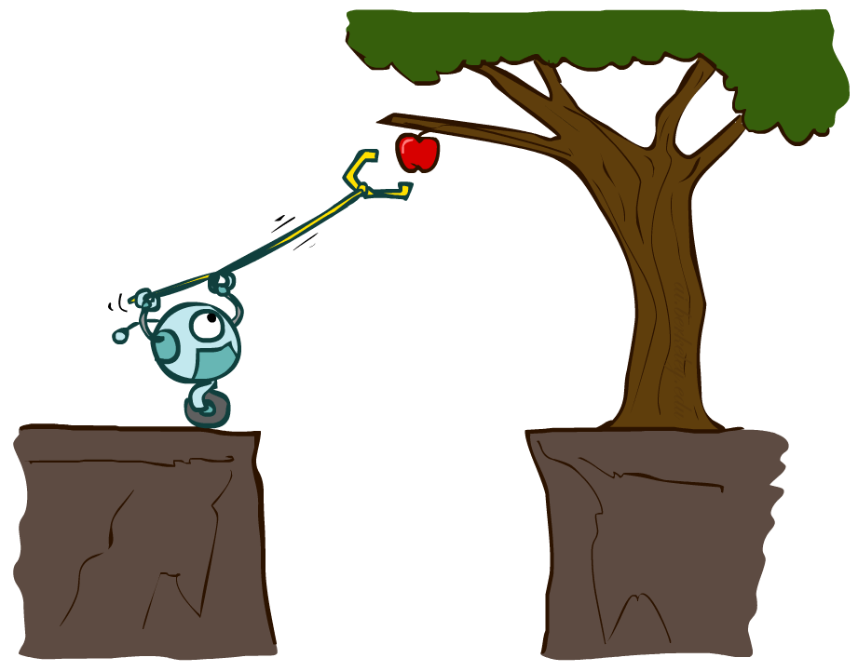
3.1 Problem-solving Agents

Slide 7
Problem-solving agent
Problem-Solving agent is a kind of goal-based agent
It solves problem by finding sequences of actions that lead to desirable states (goals) by using information about the world,
with this information about the world, the agent can follow this four-phase problem-solving process:
Goal Formulation
Problem Formulation
Search
Execution

Slide 8
Goal Formulation
The goal is formulated as a set of world states, in which the goal is satisfied
Goals organize behavior by limiting the objectives and hence the actions to be considered.
Reaching from initial state → goal state
Actions are required
Actions are the operators
causing transitions between world states
Actions should be abstract enough at a certain degree, instead of very detailed
E.g., turn left VS turn left 30 degree, etc.

Slide 9
Problem Formulation
The process of deciding
what actions and states to consider
The agent devises a description of the states and actions necessary to reach the goal—an abstract model of the relevant part of the world.
E.g., driving Mecca → Madinah
in-between states and actions defined
States: Some places in Mecca & Madinah
Actions: Turn left, Turn right, go straight, accelerate & brake, etc.

Slide 10
Target Environment
Static Environment
Fully Observable
Yes
Deterministic
Yes
Sequential
Yes
No
Discrete
Discrete
Yes
No
Yes
No
Planning,
Heuristic Search
Control Cybernetics
Vector Search: Constraint Satisfaction
Continuous Function Optimization
Notes:
Fully observable: The agent's sensors give it access to the complete state of the environment at each point in time
Deterministic: The next state of the environment is completely determined by the current state and the agent’s action
Sequential: The he current decision could affect all future decisions. i.e. the can have long-term consequences
Discrete: The environment provides a fixed number of distinct percepts, actions, and environment states

Slide 11
Search
Before taking any action in the real world, the agent simulates sequences of actions in its model, searching until it finds a sequence of actions that reaches the goal.
Such a sequence is called a solution.
the solution to any problem is a fixed sequence of actions.
The process of looking for a sequence of actions that reaches the goal is called search.
A search algorithm takes a problem as input and returns a solution in the form of an action sequence.
Once a solution is found, the actions it recommends can be carried out. This is called the execution phase.

Slide 12
Well-Defined Problems
A problem is defined by five components:
1) Initial State
The initial state that the agent starts in, which is one of the state space.
2) Actions
A description of the possible actions available to the agent
3) Transition model or (Successor functions)
A description of what each action does specified by a function RESULT(s, a) that returns the state that results from doing action a in state s.
Together, the initial state, actions, and transition model implicitly define the state space of the problem—the set of all states reachable from the initial state by any sequence of actions. The state space forms a directed network or graph in which the nodes are states and the links between nodes are actions. A path in the state space is a sequence of states connected by a sequence of actions.
Notes:
(successor functions): refer to any state reachable from given state by a single action

Slide 13
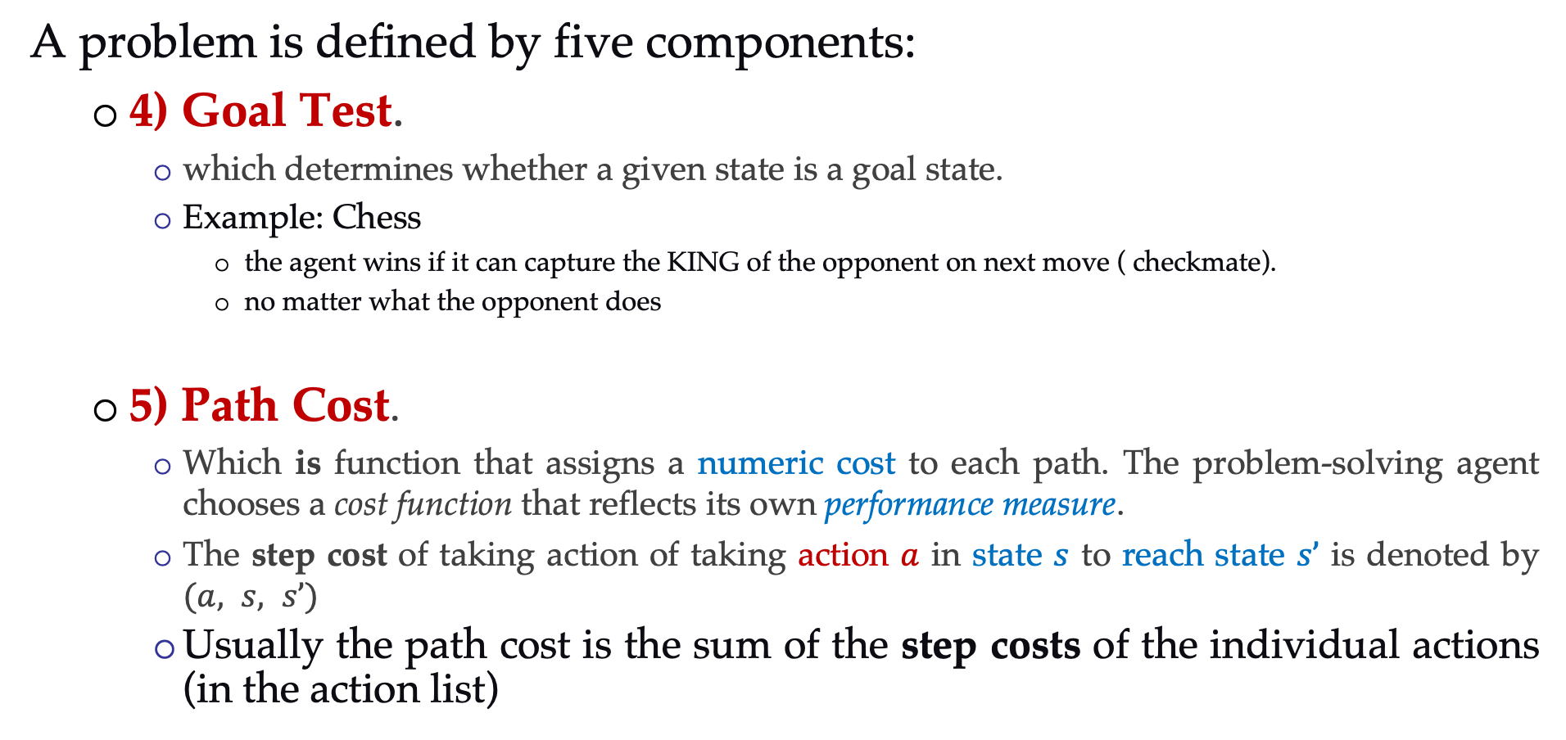
Well-Defined Problems
A problem is defined by five components:
4) Goal Test.
which determines whether a given state is a goal state.
Example: Chess
the agent wins if it can capture the KING of the opponent on next move ( checkmate).
no matter what the opponent does
5) Path Cost.
Which is function that assigns a numeric cost to each path. The problem-solving agent chooses a cost function that reflects its own performance measure.
The step cost of taking action of taking action $a$ in state $s$ to reach state $s’$ is denoted by $(a, s, s’)$
Usually the path cost is the sum of the step costs of the individual actions (in the action list)
Notes:
The goal test
Applied to the current state to test if the agent is in its goal
-Sometimes there is an explicit set of possible goal states. (example: in Amman).
-Sometimes the goal is described by the properties instead of stating explicitly the set of states

Slide 14
Well-Defined Problems and Solutions
The solution of a problem is
a path from the initial state to a state satisfying the goal test.
Optimal solution
the solution with lowest path cost among all solutions

Slide 15
Formulating Problems
Besides the components for problem formulation we need
Abstraction
the process to take out the irrelevant information
leave the most essential parts to the description of the states
( Remove detail from representation)
Conclusion: Only the most important parts that are contributing to searching are used

Slide 16
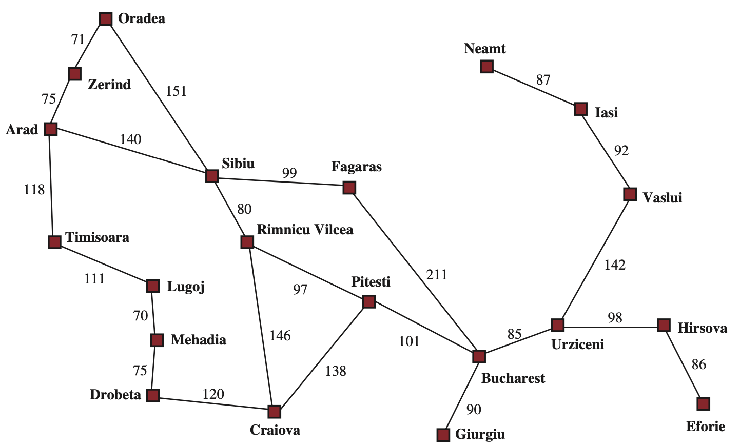
State Space
The state space can be represented as a graph in which the vertices are states and the directed edges between them are actions.
The map of Romania is such a graph, where each road indicates two actions, one in each direction.

Slide 17
Evaluation Criteria
formulation of a problem as search task
basic search strategies
important properties of search strategies
selection of search strategies for specific tasks
Notes:
(The ordering of the nodes in FRINGE defines the search strategy)
In computer science, fringe search is a graph search algorithm that finds the least-cost path from a given initial node to one goal node. In essence, fringe search is a middle ground between A* and the iterative deepening A* variant (IDA*).

Slide 18
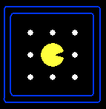
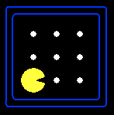
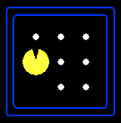
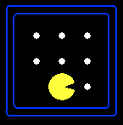



Search Problems
A search problem consists of:
A state space
A successor function
(with actions, costs)
A start state and a goal test
A solution is a sequence of actions (a plan) which transforms the start state to a goal state
“N”, 1.0
“E”, 1.0
Notes:
Abstraction. Useful for later topics.
Goal test – sometimes more than one state that satisfies having achieved the goal, for example, “eat all the dots”

Slide 19
Search algorithm
Defined as
taking a problem
and returns a solution
Once a solution is found
the agent follows the solution
and carries out the list of actions – execution phase
Design of an agent
“Formulate, search, execute”

Slide 20

Search Problems Are Models
Models aren’t perfect.
Too detailed, you can’t solve.
Not detailed enough, doesn’t solve.
In general, an agent with several immediate options of unknown value can decide what to do by first examining future actions that eventually lead to states of known value.

Slide 21
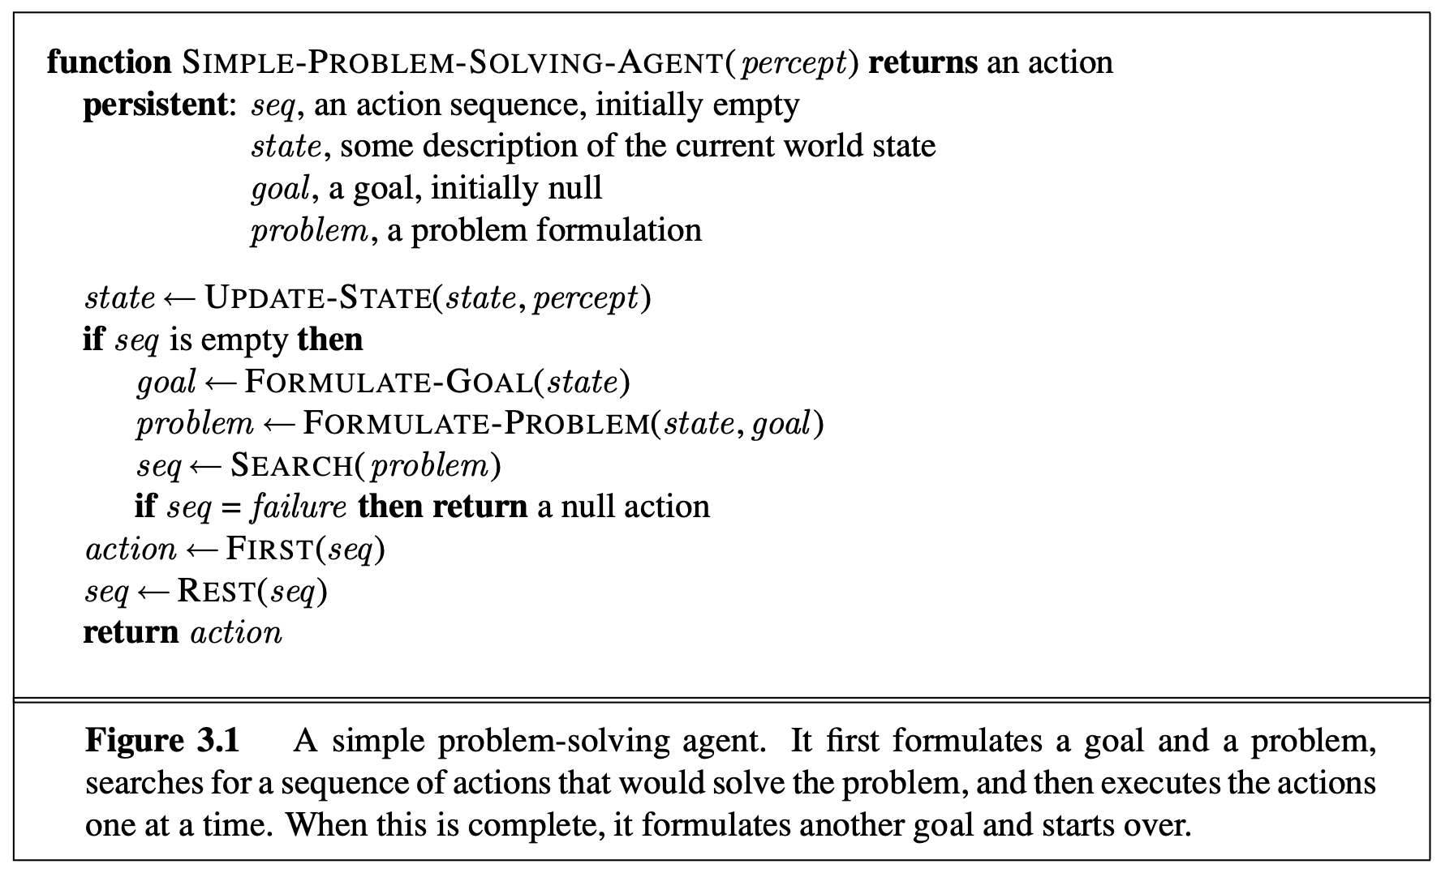

Slide 22
3.2 Example Problems

Slide 23
Problem-Solving Approach
The problem-solving approach has been applied to a vast array of task environments.
Toy problem vs Real-world problem
A toy problem is intended to illustrate or exercise various problem-solving methods. It can be given a concise, exact description and hence is usable by different researchers to compare the performance of algorithms.
A real-world problem is one whose solutions people actually care about. Such problems tend not to have a single agreed-upon description, but we can give the general flavor of their formulations.

Slide 24
Toy Problem – Example 1
vacuum world , it can be formulated as a problem as follows:
States: The state is determined by both the agent location and the dirt locations. The agent is in one of two locations, each of which might or might not contain dirt. Thus, there are 2 × 2² = 8 possible world states.
A larger environment with n locations has n · 2^{n} states.
Initial state: Any state can be designated as the initial state.
Actions: In this simple environment, each state has just three actions: Left, Right, and Suck. Larger environments might also include Up and Down.
Transition model: The actions have their expected effects, except that moving Left in the leftmost square, moving Right in the rightmost square, and Sucking in a clean square have no effect.
Goal test: This checks whether all the squares are clean.
Path cost: Each step costs 1, so the path cost is the number of steps in the path.
Compared with the real world, this toy problem has discrete locations, discrete dirt, reliable cleaning, and it never gets any dirtier.

Slide 25
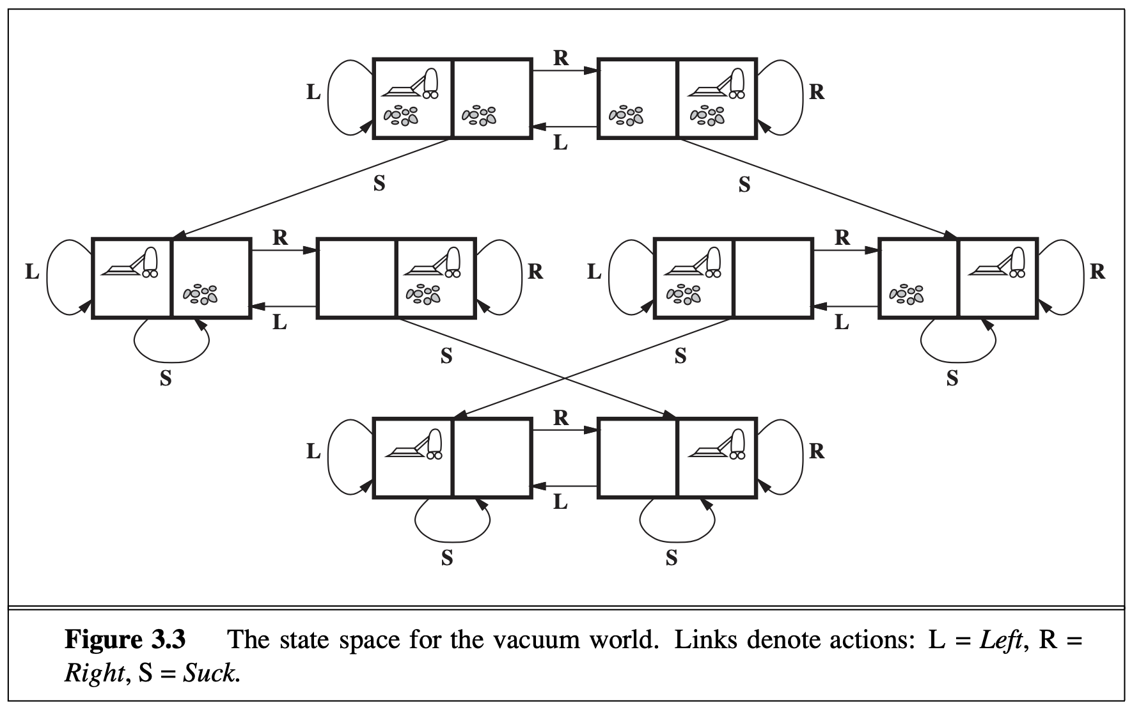
Toy Problem – Example 1

Slide 26
Toy Problem – Example 2
The 8-puzzle consists of a 3×3 board with eight numbered tiles and a blank space. A tile adjacent to the blank space can slide into the space. The object is to reach a specified goal state, such as the one shown on the right of the figure. The standard formulation is as follows:
States: A state description specifies the location of each of the eight tiles and the blank in one of the nine squares.
Initial state: Any state can be designated as the initial state. Note that any given goal can be reached from exactly half of the possible initial states.
Actions: The simplest formulation defines the actions as movements of the blank space Left, Right, Up, or Down. Different subsets of these are possible depending on where the blank is.
Transition model: Given a state and action, this returns the resulting state; for example, if we apply Left to the start state in Figure, the resulting state has the 5 and the blank switched.
Goal test: This checks whether the state matches the goal configuration.
Other goal configurations are possible.
Path cost: Each step costs 1, so the path cost is the number of steps in the path.

Slide 27
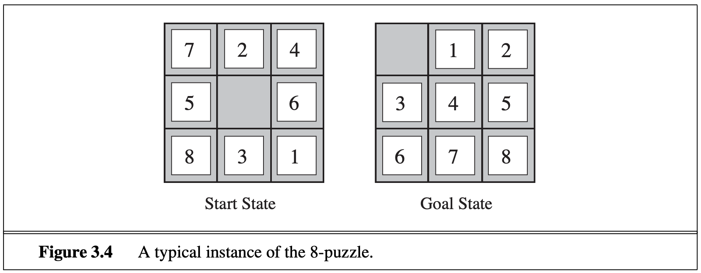
Toy Problem – Example 2

Slide 28
Real-world Problem: Example
Consider the airline travel problems that must be solved by a travel-planning Web site:
States: Each state obviously includes a location (e.g., an airport) and the current time. Furthermore, because the cost of an action (a flight segment) may depend on previous segments, their fare bases, and their status as domestic or international, the state must record extra information about these “historical” aspects.
Initial state: This is specified by the user’s query.
Actions: Take any flight from the current location, in any seat class, leaving after the current time, leaving enough time for within-airport transfer if needed.
Transition model: The state resulting from taking a flight will have the flight’s destination as the current location and the flight’s arrival time as the current time.
Goal test: Are we at the final destination specified by the user?
Path cost: This depends on monetary cost, waiting time, flight time, customs and im- migration procedures, seat quality, time of day, type of airplane, frequent-flyer mileage awards, and so on.
Notes:
Traffic, gas, accidents, time of day, etc.
Bit of art figuring out state space, etc.

Slide 29
Real-world Problem: Example
Traveling in Romania
State space:
Cities
Successor function:
Roads: Go to adjacent city with cost = distance
Start state:
Arad
Goal test:
Is state == Bucharest?
Solution?
Notes:
Traffic, gas, accidents, time of day, etc.
Bit of art figuring out state space, etc.

Slide 30
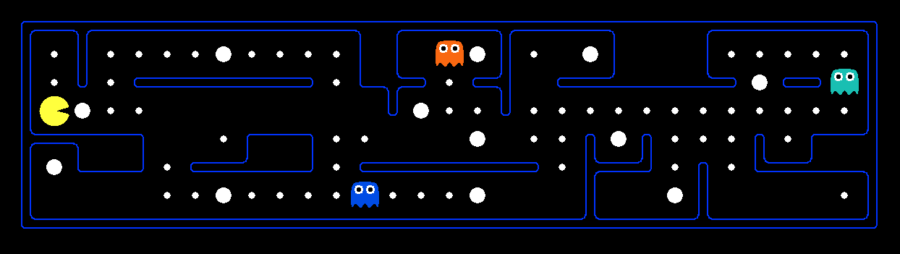
What’s in a State Space?
The world state includes every last detail of the environment
A search state keeps only the details needed for planning (abstraction)
Problem: Pathing
States: (x, y) location
Actions: NSEW
Successor: update location only
Goal test: is (x, y)=END
Problem: Eat-All-Dots
States: {(x, y), dot booleans}
Actions: NSEW
Successor: update location & possibly a dot boolean
Goal test: dots all false
Notes:
Wrong example for “eat-all-dots”: (x, y, dot count). Need bool.
World >= State
Walls? Part of successor.

Slide 31
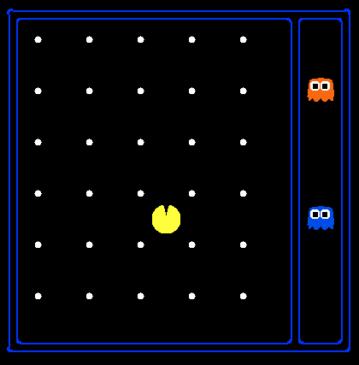
State Space Sizes?
World state:
Agent positions: 120
Food count: 30
Ghost positions: 12
Agent facing: NSEW
How many
World states?
120x(2³⁰)x(12²)x4
States for pathing?
120
States for eat-all-dots?
120x(2³⁰)
Notes:
12x10 grid

Slide 32
Safe Passage
Problem: eat all dots while keeping the ghosts perma-scared
What does the state space have to specify?
(agent position, dot booleans, power pellet booleans, remaining scared time)
Notes:
Eat power pellets. Ignore ghost reset. What do you need in state space?
Do you need ghost positions?
What’s in the state vs. successor function?

Slide 33
3.3. Searching For Solutions

